Slide 1
Chase - Quiz
DUE DATE JUNE 10
LIVE: June 13

Slide 2
Synapses
Build out quiz to the exact specifications that the USA Today Quiz is built to
http://www.usatoday.com/pages/interactives/sponsor-quiz/#data/usatoday/2016/quizzes/money/whats-your-fraud-iq/
Word Documents have translated Version of the Quiz and articles for the quiz
The in following slides is the user flow of the quiz
Directions on stipulations when readers answer answers correctly
· Article 1 is for people that got 7-9 correct answers
· Article 2 is for people who got 4-6 correct answers
· Article 3 is for people who got 1-3 correct answers

Slide 3
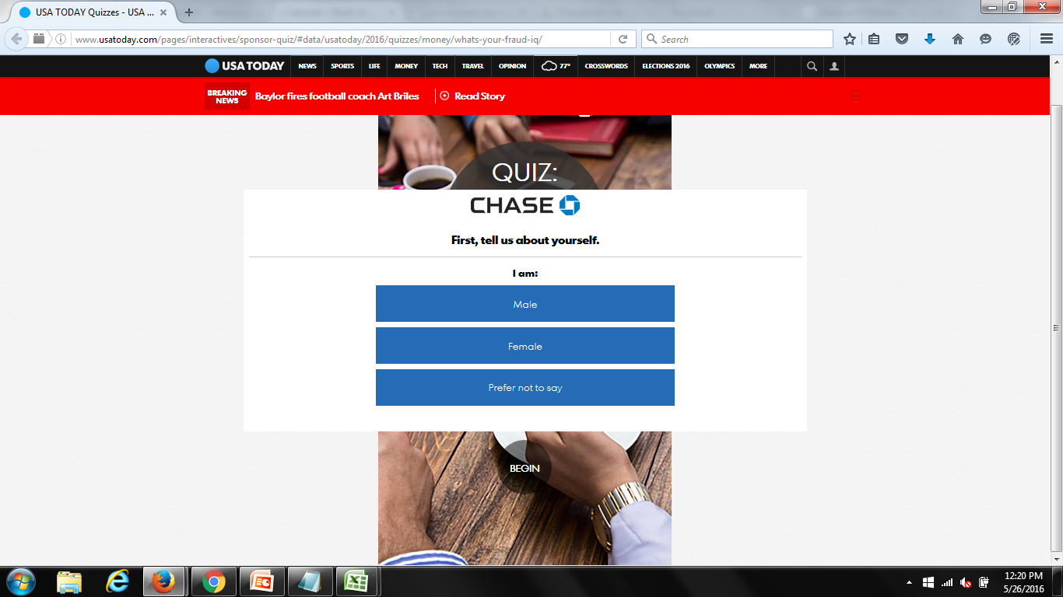
Slide one

Slide 4
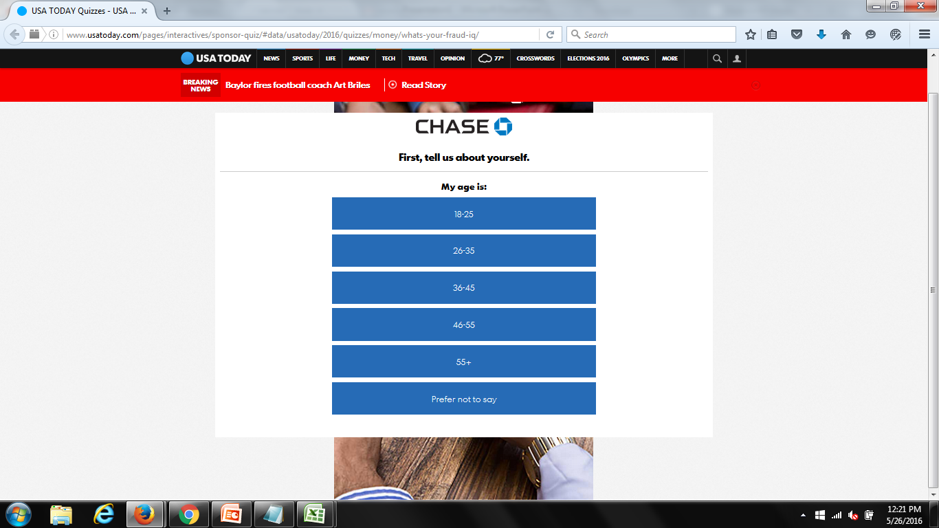
Slide two

Slide 5
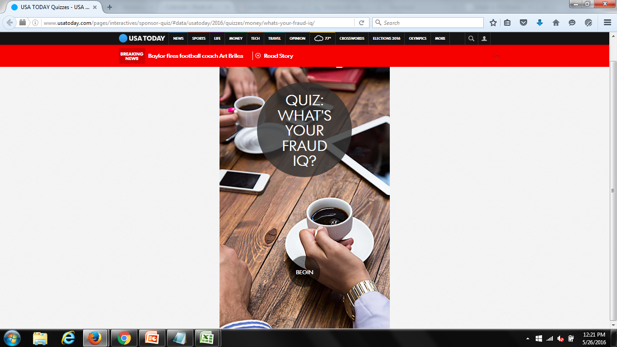
Slide Three

Slide 6
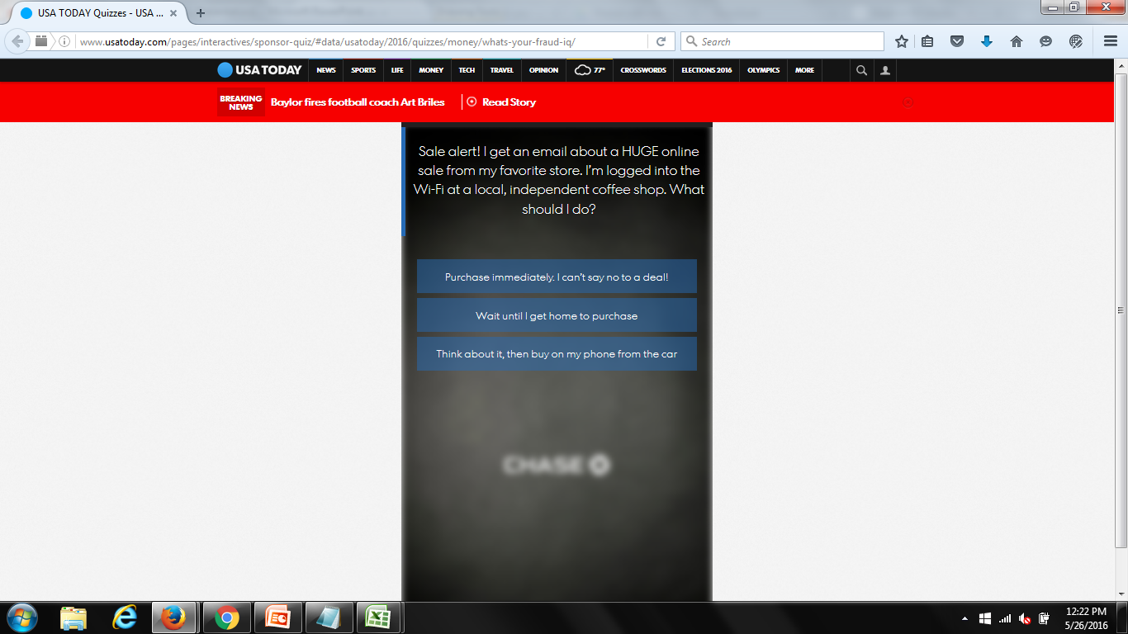
Slide Four

Slide 7
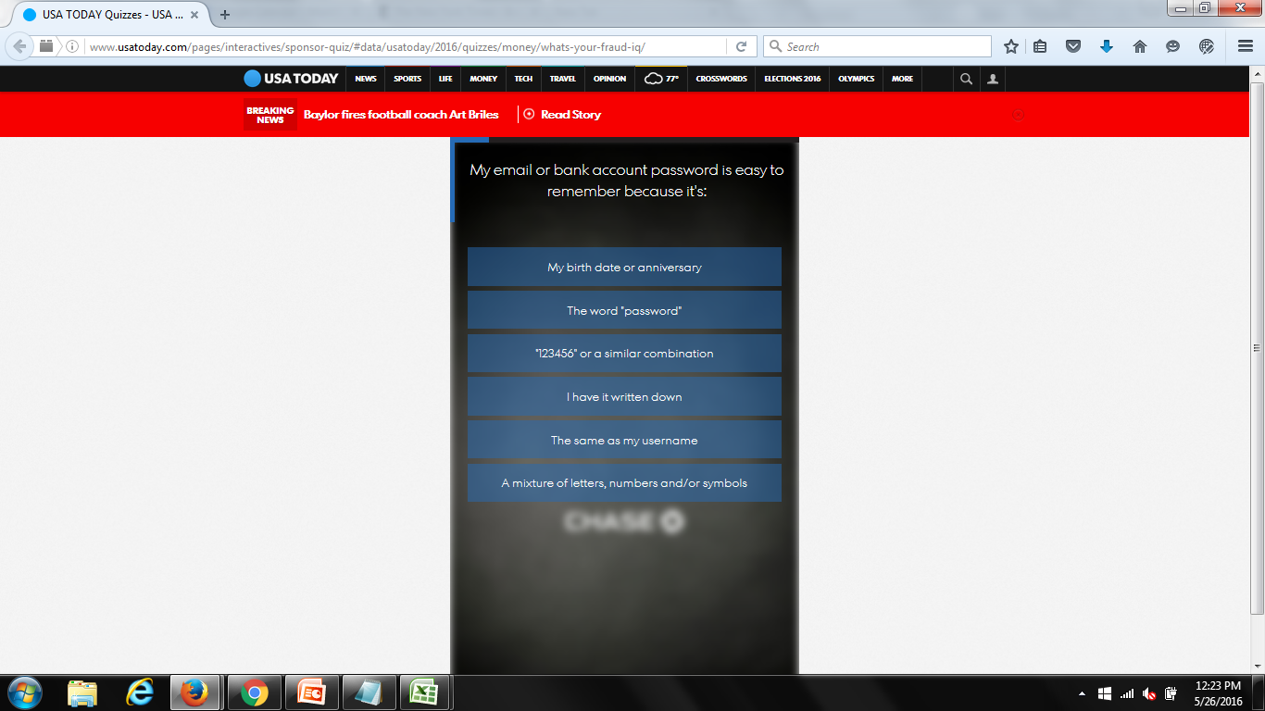
Slide Five

Slide 8
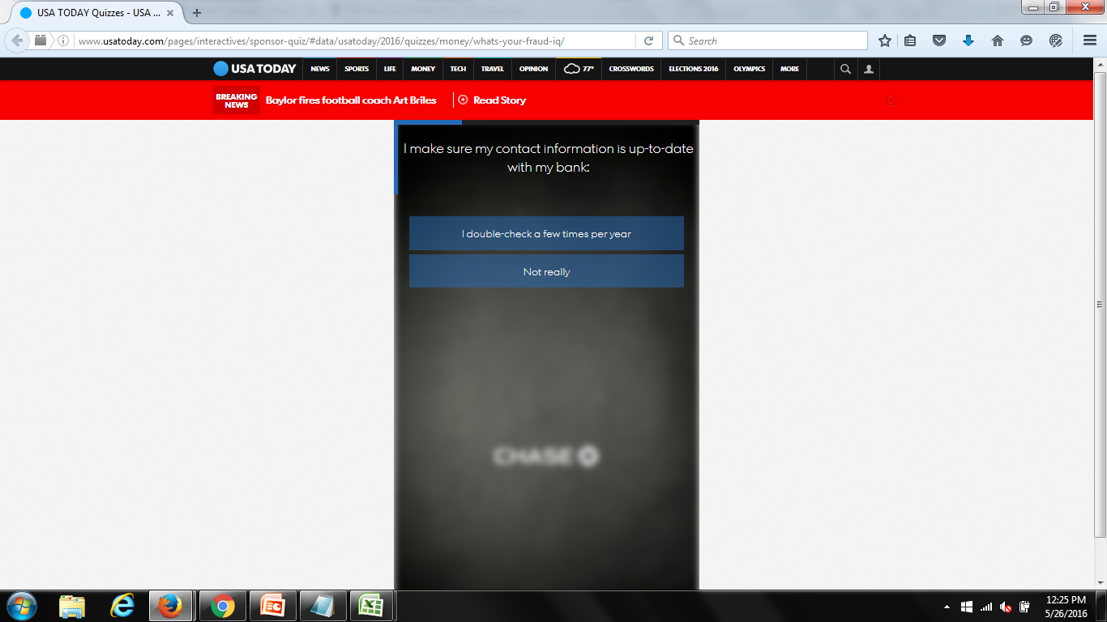
Slide Six

Slide 9
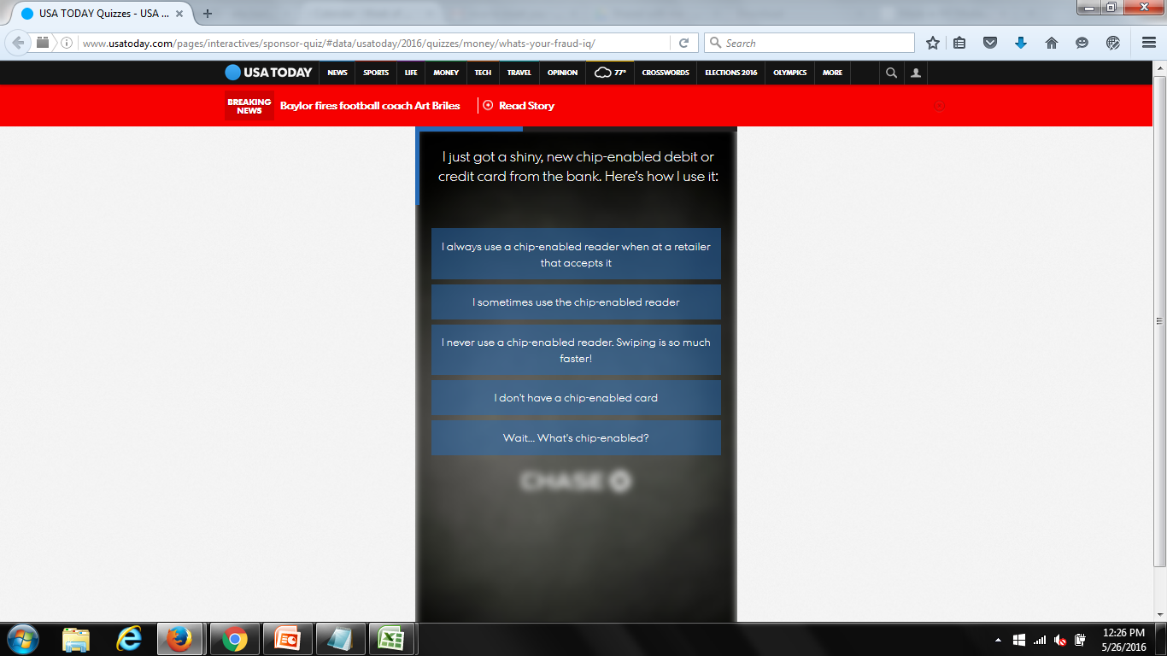
Slide Seven

Slide 10

Slide Eight

Slide 11

Slide Nine

Slide 12
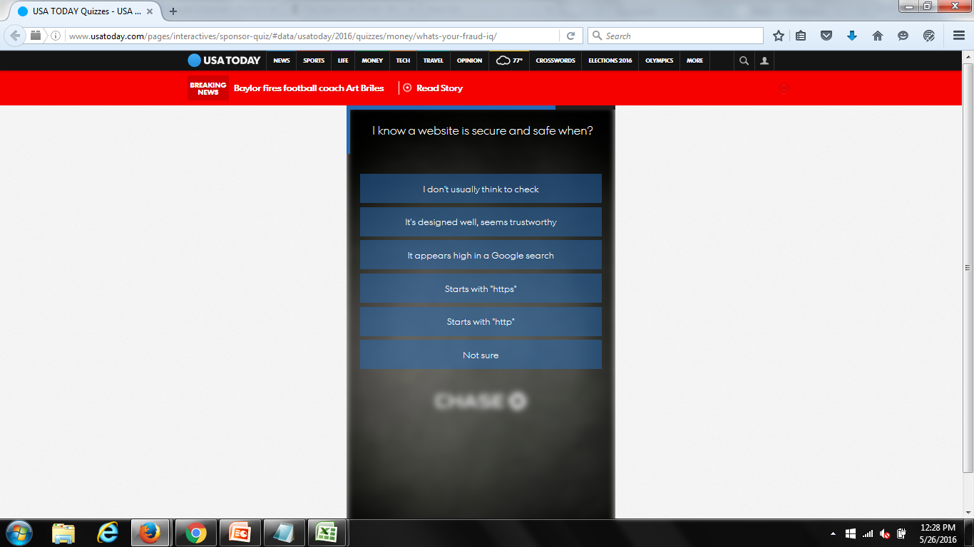
Slide Ten

Slide 13

Slide Eleven

Slide 14
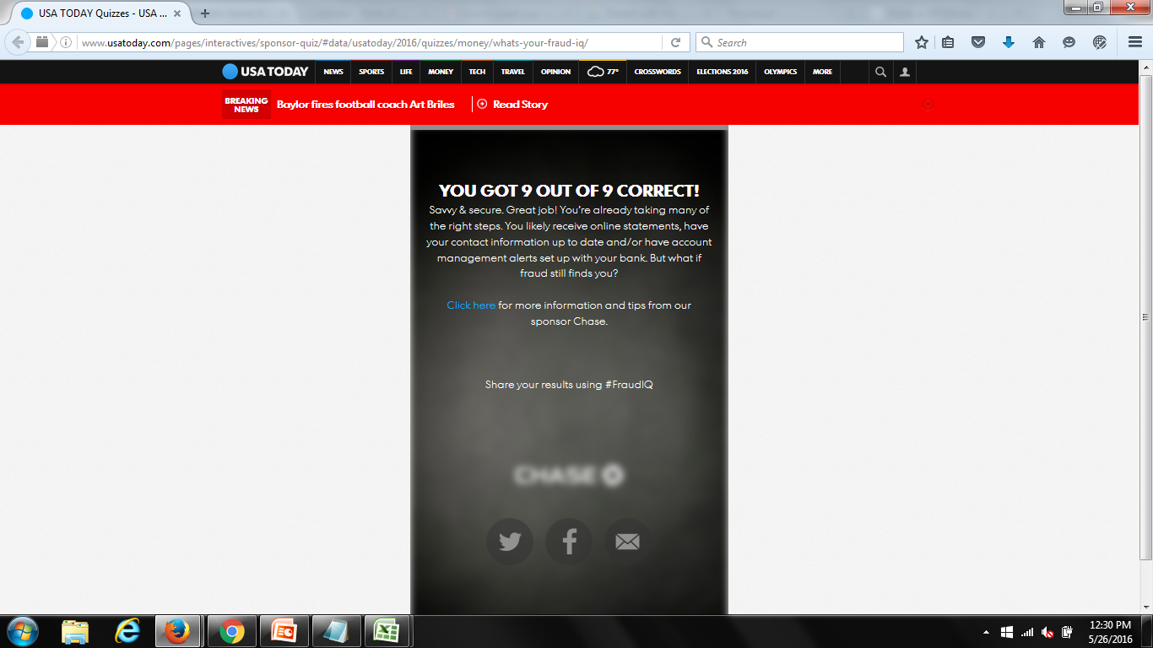
Slide Twelve

Slide 15
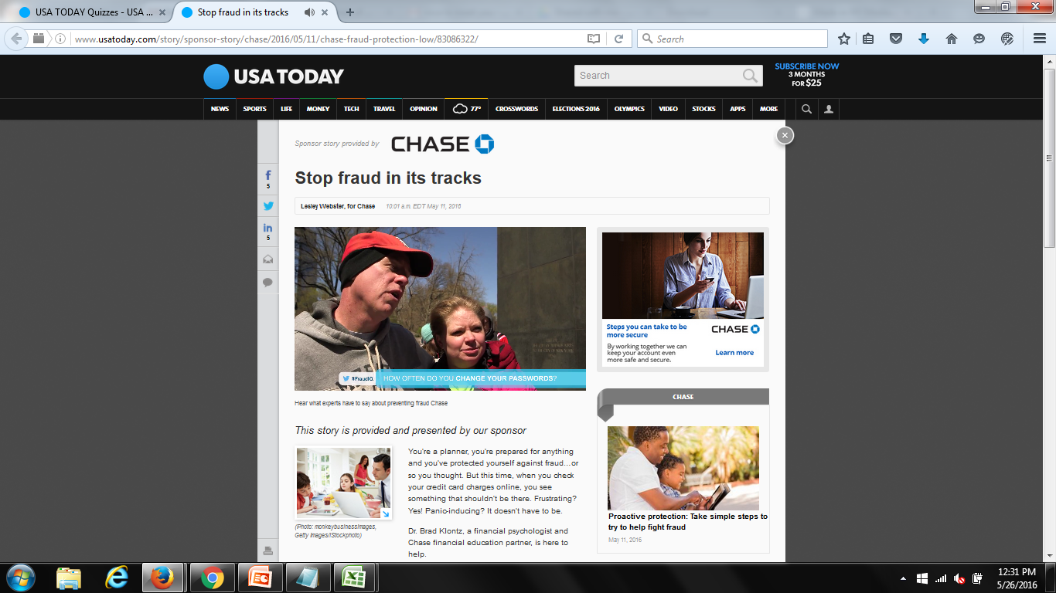
Slide Thirteen
http://www.usatoday.com/story/sponsor-story/chase/2016/05/11/chase-fraud-protection-low/83086322/

